Slide 1
Mastering the Art of Form Filling:
A Guide for Residents
CREDENTIALS COMMITTEE
Dr Bergamino Chiara
Dr Morabito Simona

Slide 2
RESIDENTS DOCUMENTATION
FORM E: ENROLLMENT FORM
FORM T and TR: THEORY APPLICATION and RETAKES
FORM P and PR: PRACTICAL APPLICATION and RETAKES
FORM SE: SUPERVISED EXTERNSHIP
FORM A: ANNUAL ACTIVITY LOG
PUBLICATIONS & PRESENTATIONS REQUIREMENTS

Slide 3

FORM E: Enrollement Form
HOW: Completed electronically when a resident sets up their account/profile on the ECVDI
website.
The form is then submitted via the website. Please also EMAIL A COPY to
adminecvdi@ecvdi.eu.
WHEN: Within 30 days of the starting date.
WHO: Resident responsibility to submit it on time.
Completed and signed by the Resident and the Supervisors/Director.
WITHIN 30 DAYS

Slide 4
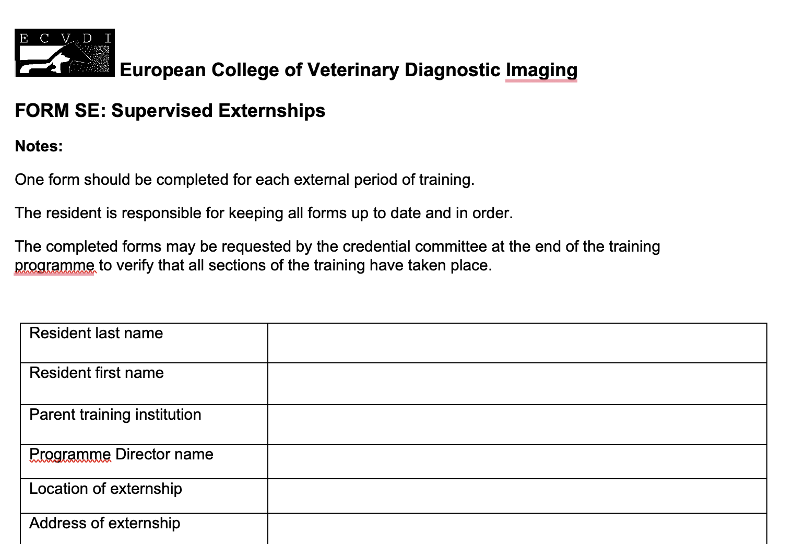
FORM SE: Supervised Externship
WHAT: One per each supervised externship.
WHEN: By the end of the training program.
WHO: Resident responsibility to submit it on time.
Completed and signed by the Resident and the Supervisors at the Externship Institution.
HOW: Upload the form on your profile on the ECVDI website AND a copy sent to adminecvdi@ecvdi.eu.

Slide 5
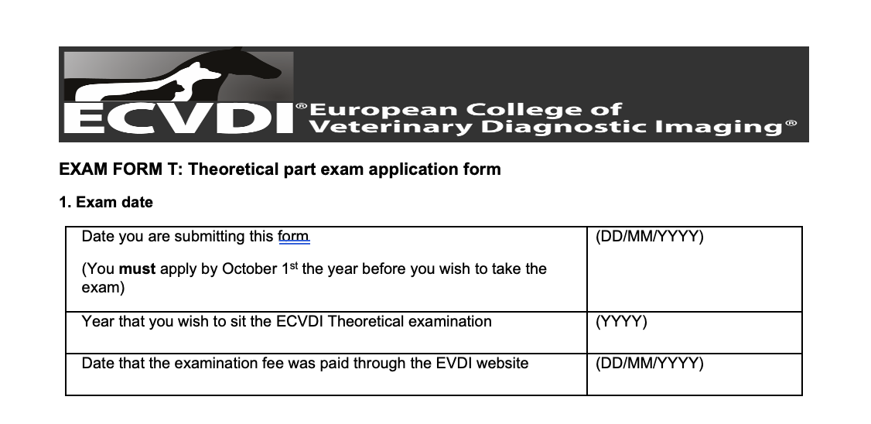
FORM T&TR: Theoretical Exam and Resit
WHEN: 1) You must apply by October 1st the year before you wish to take the exam (Sept 1-Oct 1st).
E.g. Exam in January 2026. Form T sent by October 1st 2025.
2) You must have completed min. 60 supervised weeks of residency by October 1st .
WHO: Resident responsibility to submit it on time.
Completed and signed by the Resident and the Supervisors/Director.
HOW: Upload the form on your profile on the ECVDI
website AND a copy sent to adminecvdi@ecvdi.eu.
Notes:
You must have completed min. 60 supervised weeks of residency by October 1st (FORM T only because if you are resitting you have already completed the minimu 60 weeks the year before.

Slide 6
Theoretical Exam APPLICATION
WHAT:
  FORM T signed and sent on time (Oct. 1st).
  Minimum 60 supervised weeks by Oct. 1st (application deadline).
  Theoretical Examination Fee paid (between Sept. 1st and Oct. 1st).
  INTERIM FORM: up to date at the date of application.
  E.g. Last Activity Form submitted in March with less than 60 weeks of supervision. Interim form to update the portfolio.
WHEN: Between Sept. 1st and Oct. 1st of the preceding year.
HOW: Upload the form on your profile on the ECVDI website
AND a copy sent to adminecvdi@ecvdi.eu.
SEPT 1
–
OCT 1

Slide 7
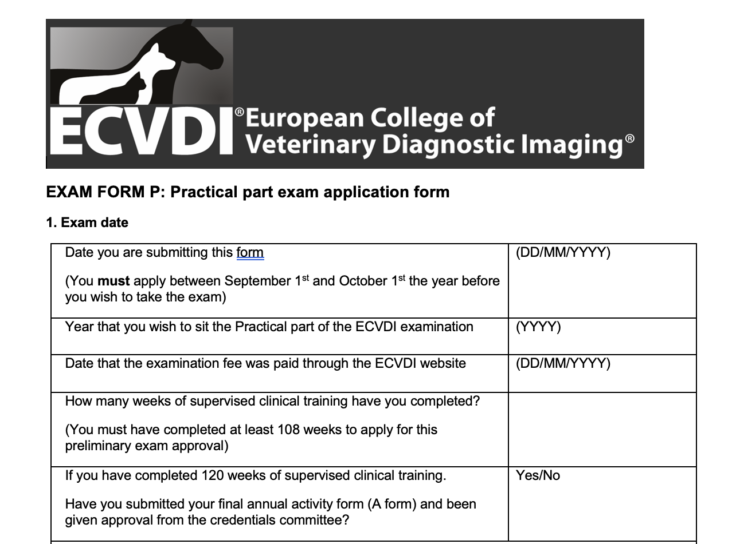
FORM P&PR: Practical Exam and Resit
WHEN: 1) You must apply by October 1st the year before you wish to take the exam.
E.g. Exam in January 2026. Documentation sent by October 1st 2025.
2) You must have completed min. 108 supervised weeks of residency by October 1st .
WHO: Resident responsibility to submit it on time.
Completed and signed by the Resident and the Supervisors/Director.
HOW: Upload the form on your profile on the ECVDI website
AND a copy sent to adminecvdi@ecvdi.eu.
SEPT 1
–
OCT 1

Slide 8
Practical Exam Application
WHAT:
  PASS result in Theoretical Examination.
  FORM P signed and sent on time Oct. 1st.
  FORM SE (supervised externship) if applicable.
  Payment of the Practical Examination Fee by Oct. 1st.
  Confirmed Case Diary to the Credentials Committee by the application deadline.
  Meeting the publication and presentation requirements by the application deadline.
  Meeting the required number of cases in each modality.
  Supervised time: min. 108 supervised weeks of residency by Oct. 1st (application deadline). If you have:
    ≥ 108 weeks and < 120:
      Interim portfolio along with application.
      Final Annual Activity Form must be submitted later, AT LEAST 1 week before the exam and is pending on credentials committee approval.
    120 weeks reached before the application deadline:
    Final Annual Activity Form already sent.
HOW: Upload the form on your profile on the ECVDI website AND a copy sent to adminecvdi@ecvdi.eu.
SEPT 1
–
OCT 1

Slide 9
Annual activity form – Form A1-2-3
WHAT: It is the annual summary of the resident
  The FORM A includes sections for updated personal details, an activity log and a supervisor’s report.
  The activity log will include, but not be limited to, details of clinical service, types and dates of external instruction, scientific meetings attended, presentations given and details of rounds attended at the training institution. The resident is responsible for making themselves aware of the content and requirements of the Annual Activity forms at the start of the programme.
WHEN: Must submit at 12-month intervals within 30 days of the anniversary of the residency start date and after completion of 132 weeks of training
E.g. Start in 1st January 2023. Documentation sent by February 1st 2024.
WHO: Resident responsibility to submit it on time. Reminders will NOT BE SENT.
Completed and signed by the Resident and the Supervisors/Director.
HOW: Download form your personal page. New form from 26th October 2023
Upload the form on your profile on the ECVDI website
AND a copy sent to adminecvdi@ecvdi.eu.

Slide 10
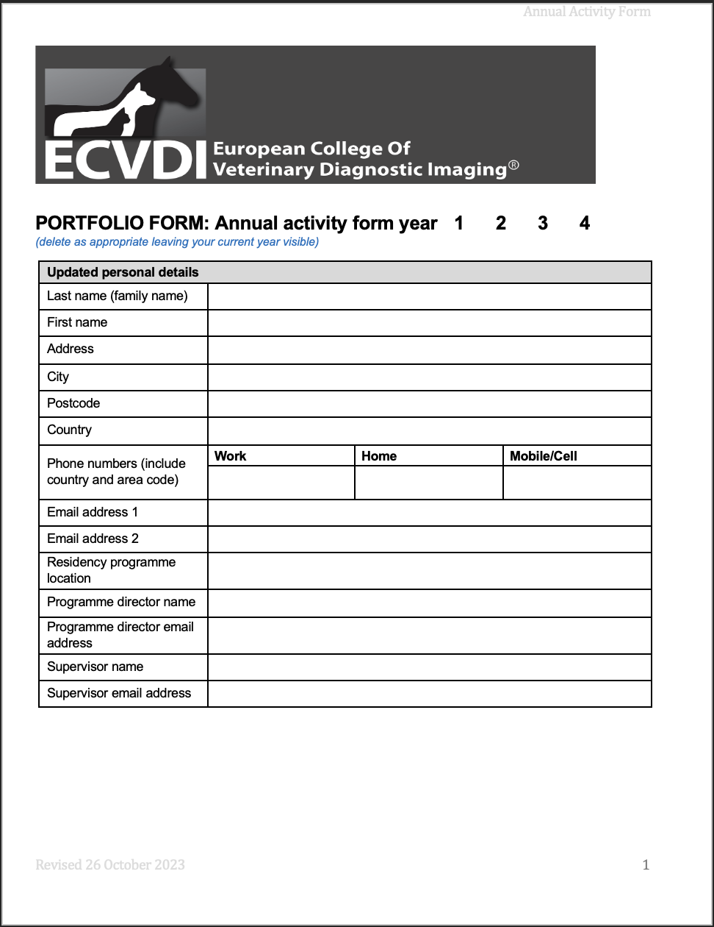
Annual activity form
    FIRST PAGE:
    Personal detail

Slide 11
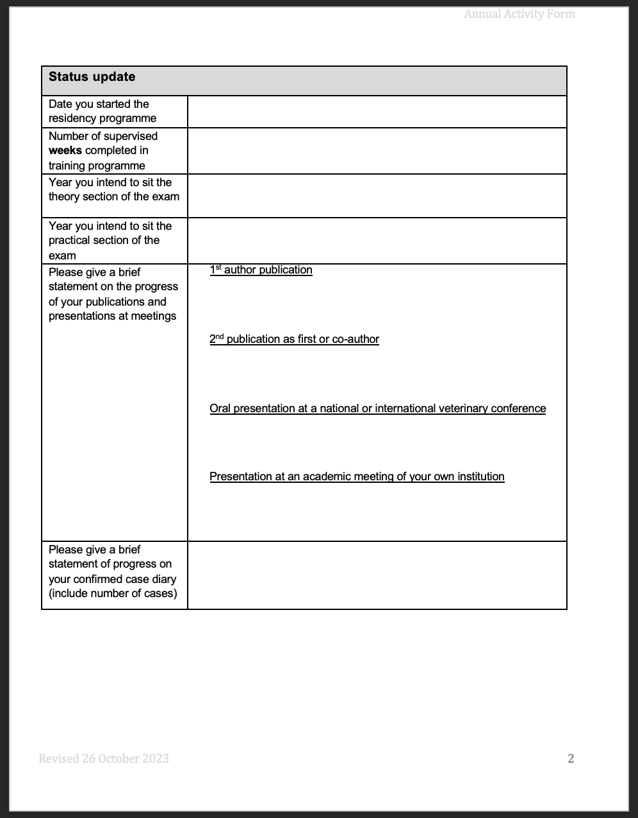
Annual activity form
    SECOND PAGE:
    Status update

Slide 12
Annual activity form
    SECOND PAGE:
    Status update

Slide 13
Annual activity form
    SECOND PAGE:
    Status update

Slide 14
Annual activity form
    SECOND PAGE:
    Status update
    Publication and presentation
Residents MUST have 2 scientific papers accepted for publication
in a branch of diagnostic imaging
in a peer-reviewed journal (English language not required):
1st author publication: one study as first author (which is not a single case report) and
2nd publication as first a second paper as first or co-author (which could be a case report).

Slide 15
Annual activity form
    SECOND PAGE:
    Status update
    Publication and presentation
Papers with an acceptance date within 2 years prior to the start date of the residency are acceptable.
Acceptance is based on the issuance of the copyright form and also based on the words ʻaccepted’ or ‘accepted subject to minor editorial reviewʼ, but not ‘accepted subject to major or minor revisions’.
Case reports by a resident (as a first author or co-author) may be in any language but must be published in a peer reviewed journals and can be accepted only as the second paper.
The case report must have:
  a veterinary diagnostic imaging topic,
  a scientific abstract,
  the word count in the main text of the paper must be at least 1500 words and
  it contains five or more references.

Slide 16
Annual activity form
    SECOND PAGE:
    Status update
    Publication and presentation
During the period of training, and before application for the practical examination,
the resident must make:
a presentation at an academic meeting of their own institution
and an oral abstract presentation at a national (English language not required) or international veterinary conference on the subject of diagnostic imaging.
Oral abstract presentations given during a period of two years prior to the start date of the residency programme are acceptable.

Slide 17
Annual activity form
    SECOND PAGE:
    Status update

Slide 18
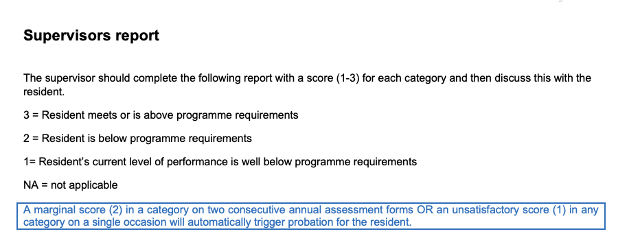
Annual activity form
    THIRD PAGE:
    Supervisors report

Slide 19
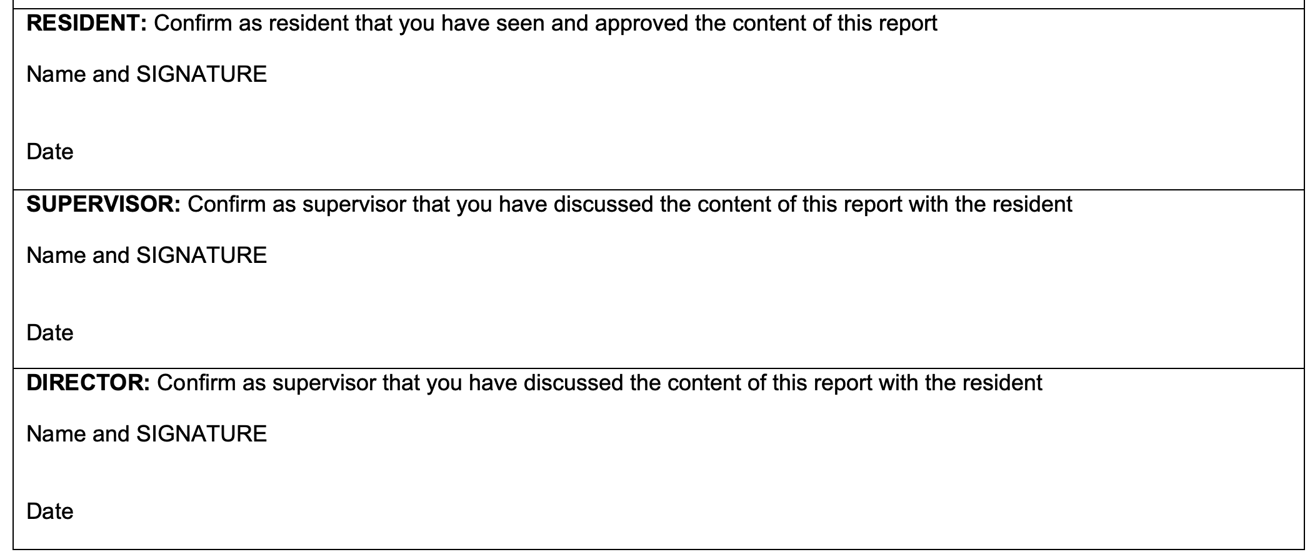
Annual activity form
    THIRD PAGE:
    Supervisors report

Slide 20
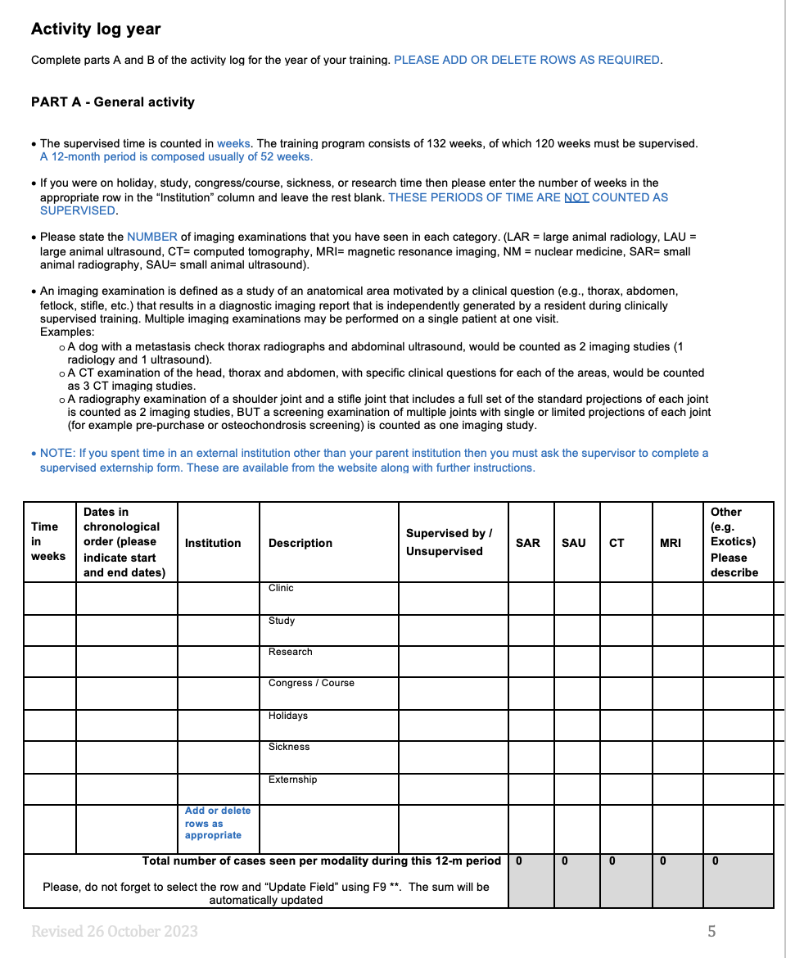
Annual activity form
    FIFTH PAGE

Slide 21
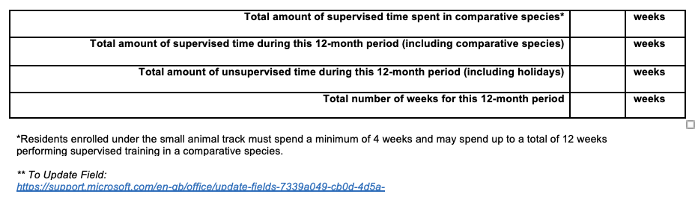
Annual activity form

Slide 22
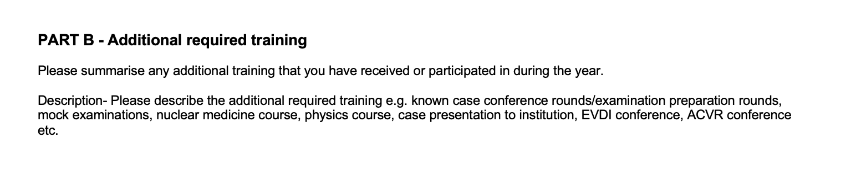
Annual activity form
Rounds between the resident and the supervisor to review and discuss interpretation of diagnostic studies, the accuracy of the written reports and case management should be held, preferably every day, or at a minimum twice a week.
Other diagnostic imaging rounds (At least once a month):
daily case reporting and discussion,
known case conferences (KCC),
mock theory and practical examinations,
journal clubs,
book review sessions and other discussion groups, at a recommended frequency of at least once a month.
National and international congress (ECVDI congress ecc.).
The resident should participate in clinical teaching of other graduate veterinarians (+/-students).

Slide 23
Case diary
The Confirmed Case Diary must be maintained throughout the residency programme and submitted to the Credentials Committee with the first application to sit the practical examination.
  No re-submission is required for re-sit applications.
Requirements
  Must include 150 interesting cases:
    “Interesting” = challenging, unusual, or worthy of record.
  Each case must have a confirmed diagnosis, obtained by:
    Surgery
    Cytology
    Histopathology
    Post-mortem
    Clinical outcome
Content and Format
  Should cover a variety of species and imaging modalities.
  No fixed ratio — resident decides distribution.
  A template is available on the ECVDI® website. - https://www.ecvdi.org/info/residents/resident-forms-
  Format: PDF, Word, or Excel.
  Residents may use their own software to track cases during training.

Slide 24
Questions?

